Slide 1
Dragons Den Presentation
Team 2

Slide 2
Firstly….
HELLO!
Notes:
Say hello to relax lloyds straight away, and possibly say something like “I’m Matt and this is <Other speaker>, and this is the rest of the development team”

Slide 3
Prototype
If it hasn’t already been clarified you will find a prototype of our future app in front of you or currently passing around the audience.
Remember it’s early days, so there’s more great innovations planned and still to come (will touch upon later).

Slide 4
What was our project choice?
Why not web or both?
Notes:
Say app, <click>, why not both I hear you cry?, Briefly explain we picked to focus on making one GREAT thing rather than two OKAY things and that we went for app over web because it played to our strengths.

Slide 5
What age range did we decide?
Why not children?
Notes:
Say students, <click>, why not children? They need banks, Briefly explain we picked students because we match that age range so it is easier to think of aims.

Slide 6
Functionality
Standard Banking Functionality -
Displays Balance
Transfers
Shows Lloyds offers
Locates Branches
Innovative Functionality –
Achievement based rewards scheme aimed at students.
A student focused finance planner (assistant)
<insert future innovations in later version of powerpoint>

Slide 7
How we designed the prototype
We developed multiple prototypes based on what we thought a banking app should be like, we then took the pros from each and combined them into one master prototype.

Slide 8
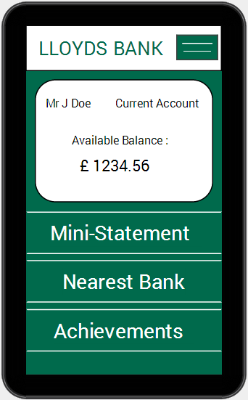
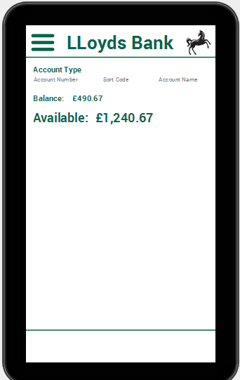
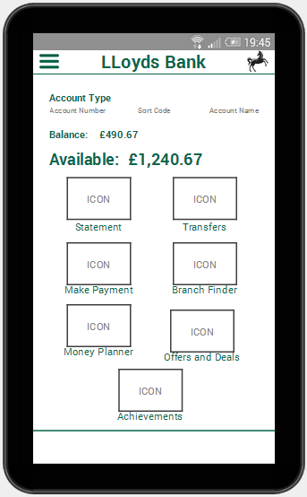
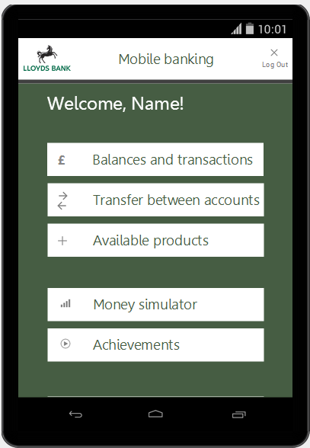
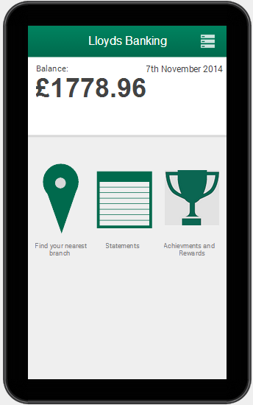
Example: Main Menu

